Slide 1
helmet and number plate recognition for motorcycles
By using Deep Learning

Slide 2
Requirements are :
Streamlit -for creating a webpage for our deep learning model
Open cv-for image processing
Numpy –array calculations
Pandas
Matplotlib- for displaying images
Imutils- for image handling
PIL-for image handling
Easyocr-character recognition model

Slide 3
Our project objective :
We are intended to detect the images or videos of motorcyclists and detect the motorcycle and the rider and check whether the rider is wearing a helmet or not.
If the rider is not wearing a helmet then we detect that particular rider and display the rider is not wearing a helmet
And detect the numberplate of that particular vehicle
And display the recognized text on that numberplate
Such we can further proceed with the data of the motorcyclists who are not wearing helmet

Slide 4
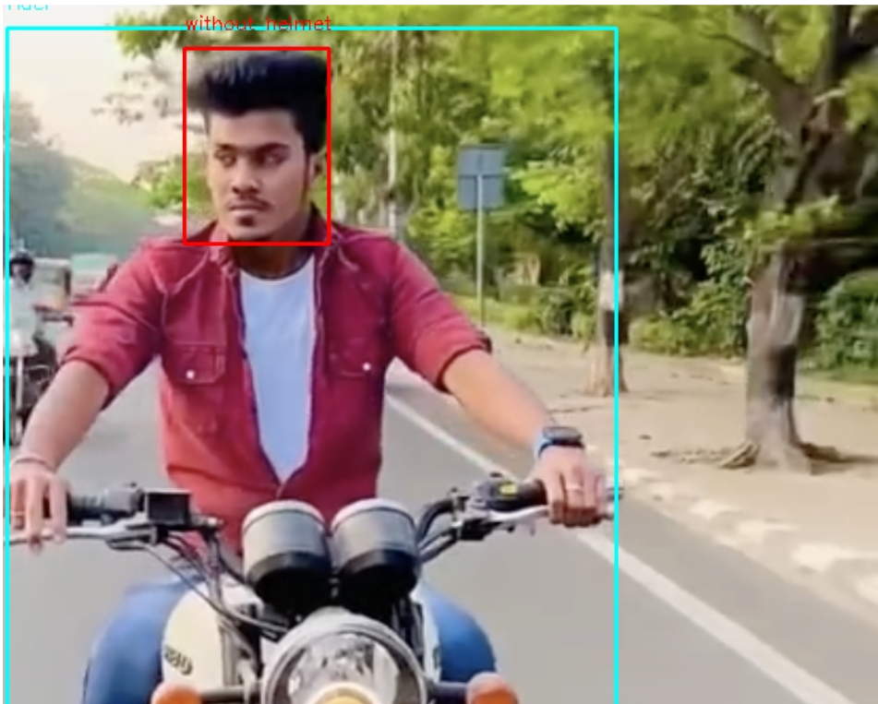
Our approach:
To implement this we used yolov8n model for detection of the motor cycle and the person and the helmet
The yolov8n is the deep learning model for object detection to detect various objects
Yolov8n is pre-trained on MS-COCO dataset.which consists of various common context objects
But our objective is to detect whether the rider is wearing a helmet.to do this we have to fine tune the exsisting yolov8 model such that to make the model to detect whether the rider is wearing helmet or not
green label→Rider
redlabel→ without helmet

Slide 5
Dataset we have used:
The dataset which we have used to fine tune our yolov8n is prepared by us .
The dataset is the combination of some publicly available images and datasets.
After exctracting various images according to our context.we have used annotation tool called roboflow.
To have customized labels that is accepeted by YOLOv8n model
The dataset format
Project dataset->
1)training folder-→images folder ,lables folder 70%
2)Validation folder->images folder,labels folder 20%
3)Testing folder->images 10%

Slide 6
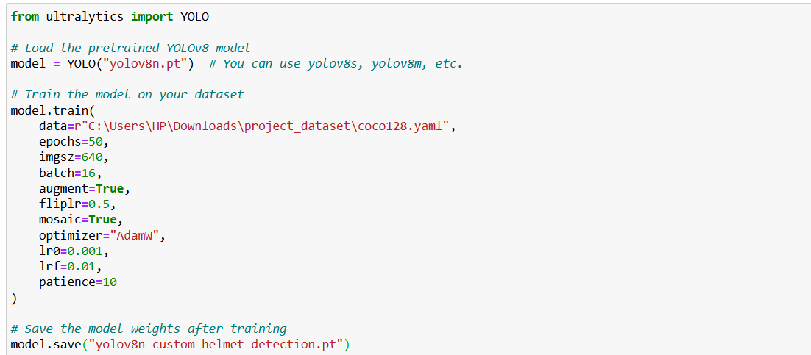
Training of yolov8n model
Training of model:
for training we have used argumentation =true
Argumentation means we using the flipped ,transformed forms of our training images as we are not using a large dataset
we are trainig dataset by adjusting the parameters
We have saved model we are going to use it further we have to write logic that if label==rider then check for helmet region

Slide 7
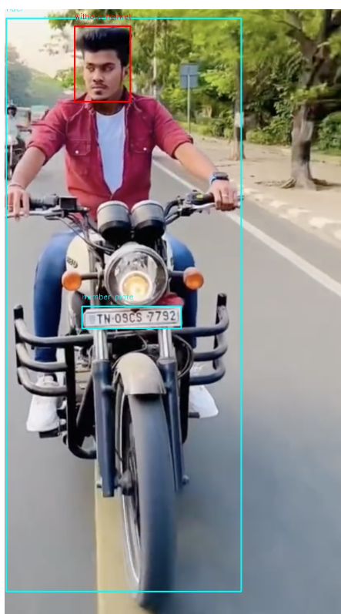
Detection by yolo model::
The model detected the motorcycle and the person seating on it and labeled it as rider
Then we have to check the head region to check whether he is wearing helmet or not
Accordingly we have to give that label
If the label==NO_helmet then we have to detect the number plate region

Slide 8
Detection of the text on the number plate region : BY EASYOCR
Now we are intending to detect the text on the detected numberplate region
To do this we are integrating easy ocr .easy ocr is a deep learning based model that is trained on the various publicly available dataset
That can detect text from images

Slide 9
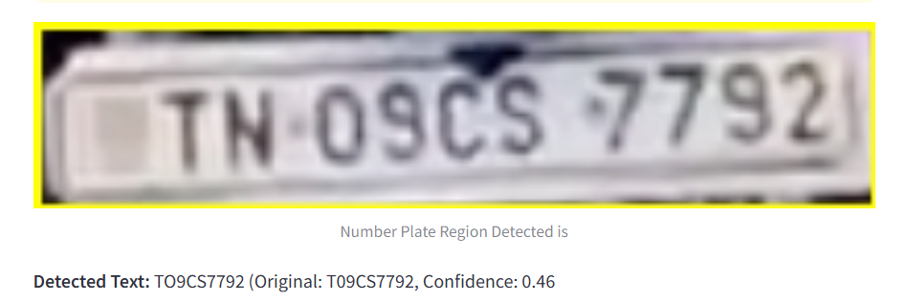
continuing
For the numberplate label we are applying the easy ocr model to detect the text on the numberplate
Before applying easy ocr we apply gray and bilateral filter to effectively detect text in noisy images
Output by easy ocr

Slide 10
Deploying our model in streamlit
Now our model is deployed into a web app by using a streamlit
Streamlit is widely used by datascienstics to deploy their machinelearning and datscience projects easily

Slide 11
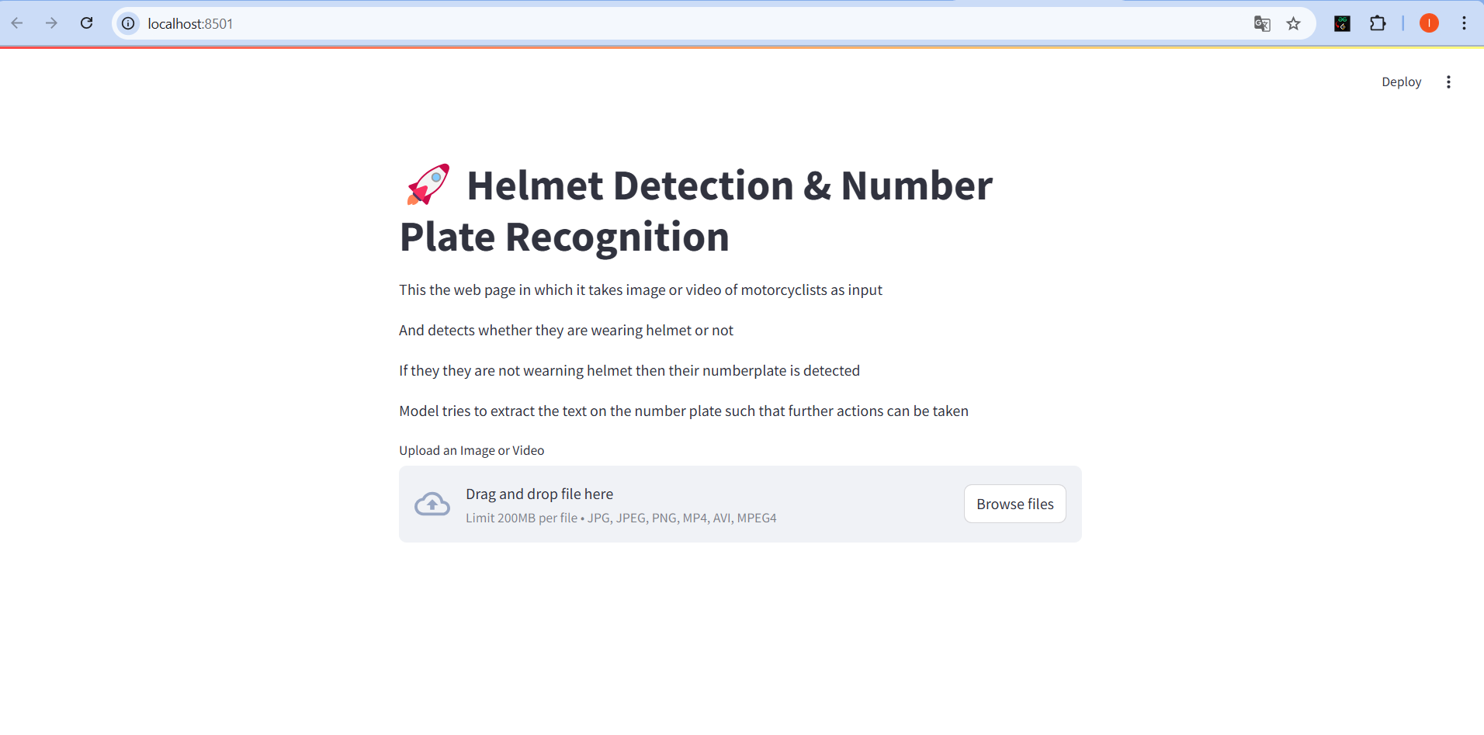
Our web app
Our web app can process images and videos

